Slide 1
Accident Prediction Time Series
Mayank Mudgal

Slide 2
Dashboard development - ETL Process
Extract
Extracting relevant data builds on Defined Requirements and typically includes Identification, Volume planning and Methodology of extract (Via Update, Incremental or Full).
Transform
Preparing the data for Analytics. This typically includes: Validation, Cleaning, De-duplication, Transformation, Filtering, Joining and Aggregation (as-required).
Load
Depending on use (BI, Real-Time Monitoring/ Alerting) the Load process differs. Considering a BI/ Analytics tool this can be via Live streaming or Batches.

Slide 3
Dashboard development - Business Requirement
No. | Business Objective | Importance | Business Requirement (Data) | Business Result (KPI)
1 | Generate insights on accident development and volatility over time | H | 1. Number of Accidents 2. Period of Accident 3. Number of associated riders | 1. Monthly Accidents 2. Monthly unique riders
2 | Generate insights on how the type of transportation affects associated accidents | H | 1. Number of Accidents 2. Type of Transportation | 1. Monthly accidents distributed by type of transportation
3 | Generate insights on how the type of employment affects associated accidents | H | 1. Number of Accidents 2. Type of Employment | 1. Monthly accidents distributed by type of employment

Slide 4
Dashboard development - Accident Prediction
Conducted supervised time-series ML models to predict/ forecast number of accidents in future months. Rationale for Time-Series selection was:
Requirements related to forecasting/ prediction based on historical data are typically solved via these approaches.
Observation that only Type of Transport and Employment have an influence on Number of Accidents. Other modelling techniques have limited business application as we would need a reliable forecast of input variables.
Mismatch in the Number of rider and expected values on other fields. (!!)
Approach, Process and Code detailed further.

Slide 5
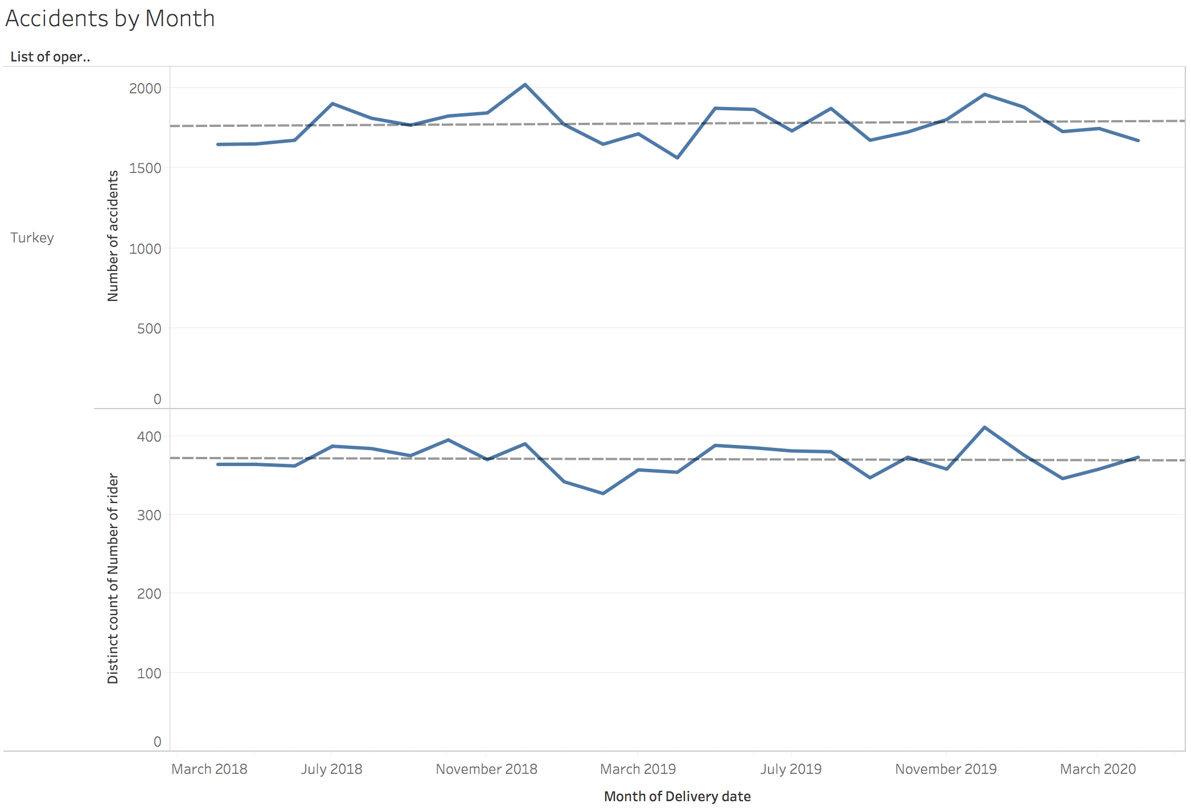
Dashboard development - KPIs (1 of 2)
Monthly development of accidents shows limited volatility (Avg: 1,776; MIN: 1,565; MAX 2,022) with a slight upward trend
Distinct riders involved shows limited volatility (Avg: 370; MIN: 327; MAX 411) with a slight downward trend

Slide 6
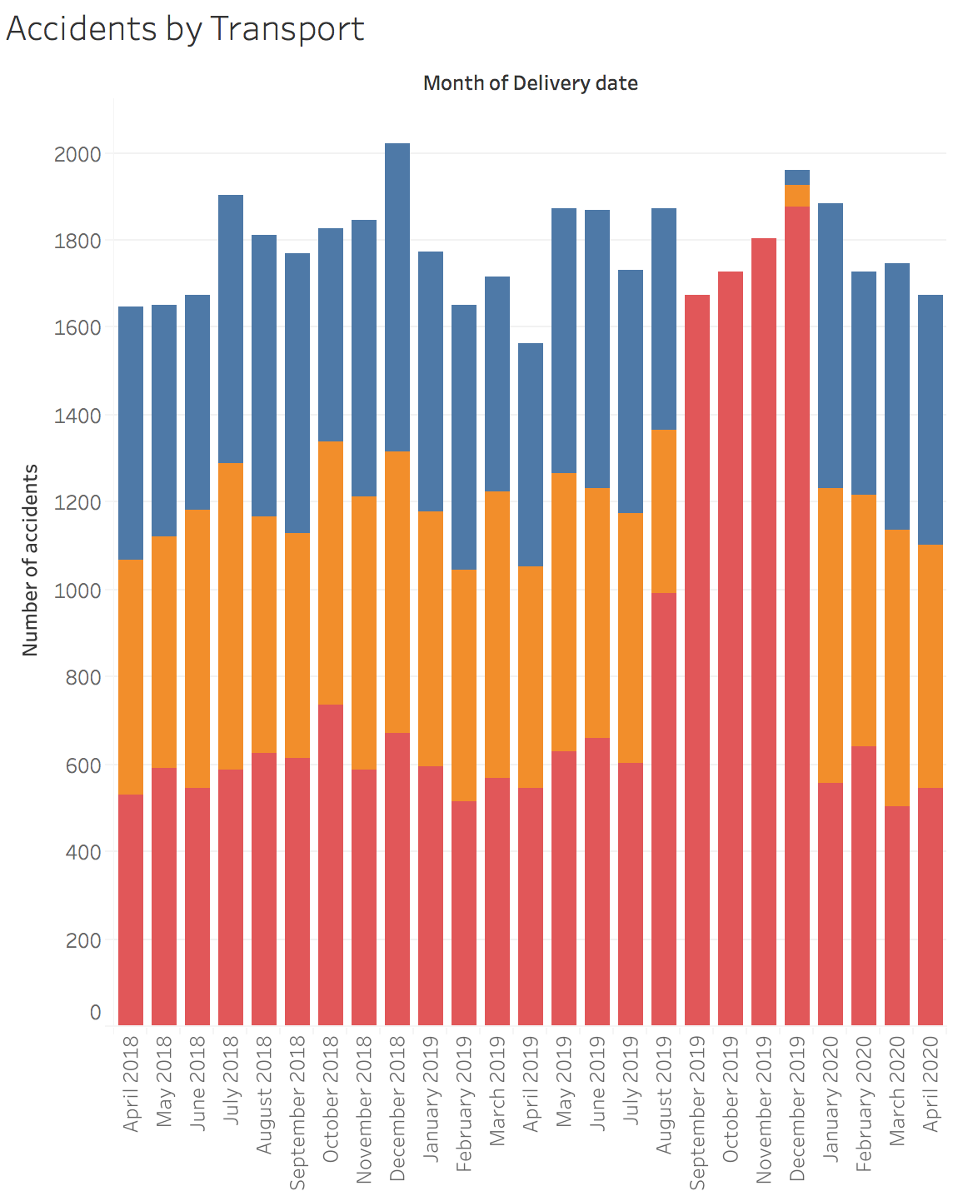
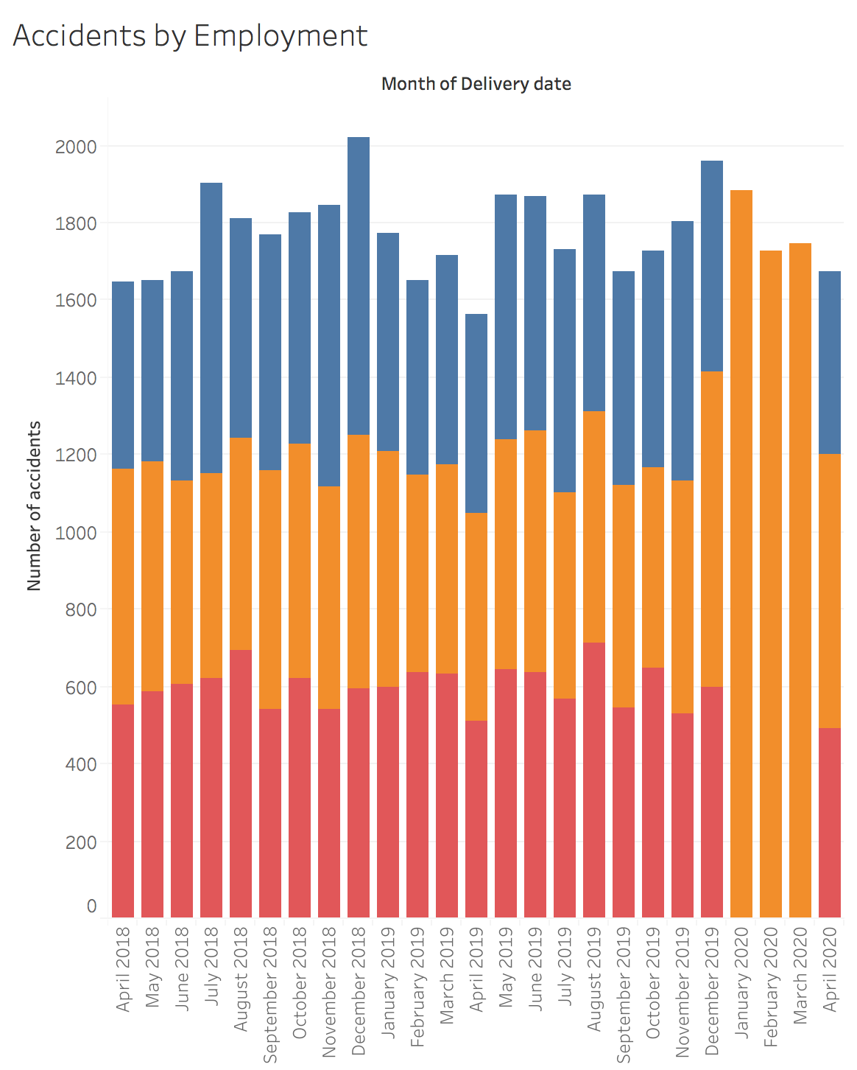
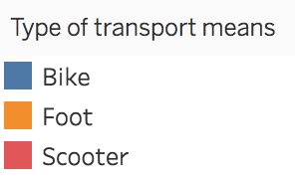
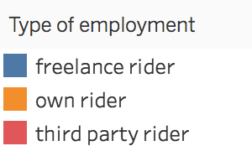
Dashboard development - KPIs (2 of 2)
Scooters have more accidents by more than 7K vs. others.
!! Period from August 2019 thru December 2019 requires investigation
Own riders have more accidents by more than 5K vs. others.
!! Period from December 2019 thru March 2020 requires investigation

Slide 7
ML - Data Sufficiency
I found the data sufficient for Time Series Modelling.
Data exploration made me question integrity of data (Unique rider number assumption and mismatched data; Observations on Slide 6). In a live working environment would have led to upstream investigation and correction.
From a broader viewpoint, I would recommend adding further data points:
Holiday periods
Weather indications (Rainfall, Snow, Smog, Fog)

Slide 8
ML - Process and Algorithm
Initial Investigation and Cleaning
Data Preparation
Model Development
and Run
Initial investigation, especially for an unknown dataset is critical. This helps clarify the dataset, structure the problem statement and conceptualise way forward.
For the given dataset I followed the below steps:
Investigate data and clean for outliers, missing values. Transform into BINs.
Check correlations and variables that influence target variable
Proceed with supervised Time series models
Setup data for time series modelling. This included:
Further Data Exploration
Checking Duration, Stationarity and Lags
Create ‘model_df’ for supervised model with lags
Steps include:
Train/ Test Split (85/15)
Create Prediction function
Create Scoring function
Creating Plotting function
Create Model run function for:
Linear Regression
Random Forest
XG Boost
LSTM
Store results

Slide 9
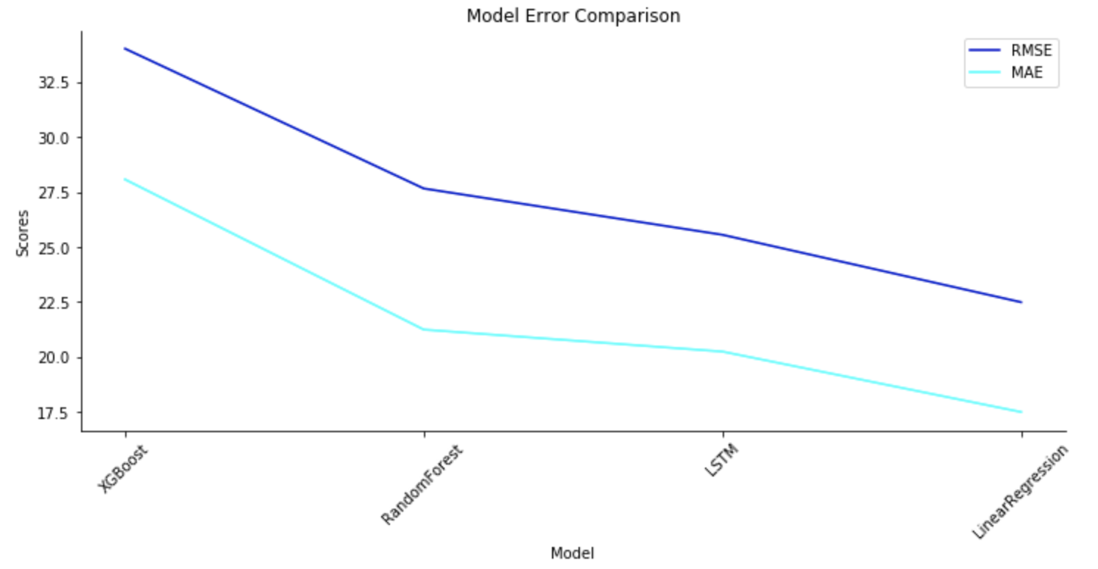
ML - Process and Algorithm | Model Results
Linear Regression model performs best with lowest error calculation (RMSE and MAE)

Slide 10
ML - Code
Sent via Email:
1_DH_Accident_Interrogation_Cleaning_Inferences.ipynb
2_DH_Accidents_EDA_Time_Series_Prep.ipynb
3_DH_Accidents_Regression_Modelling.ipynb
4_DH_Accidents_Results.ipynb

Slide 11
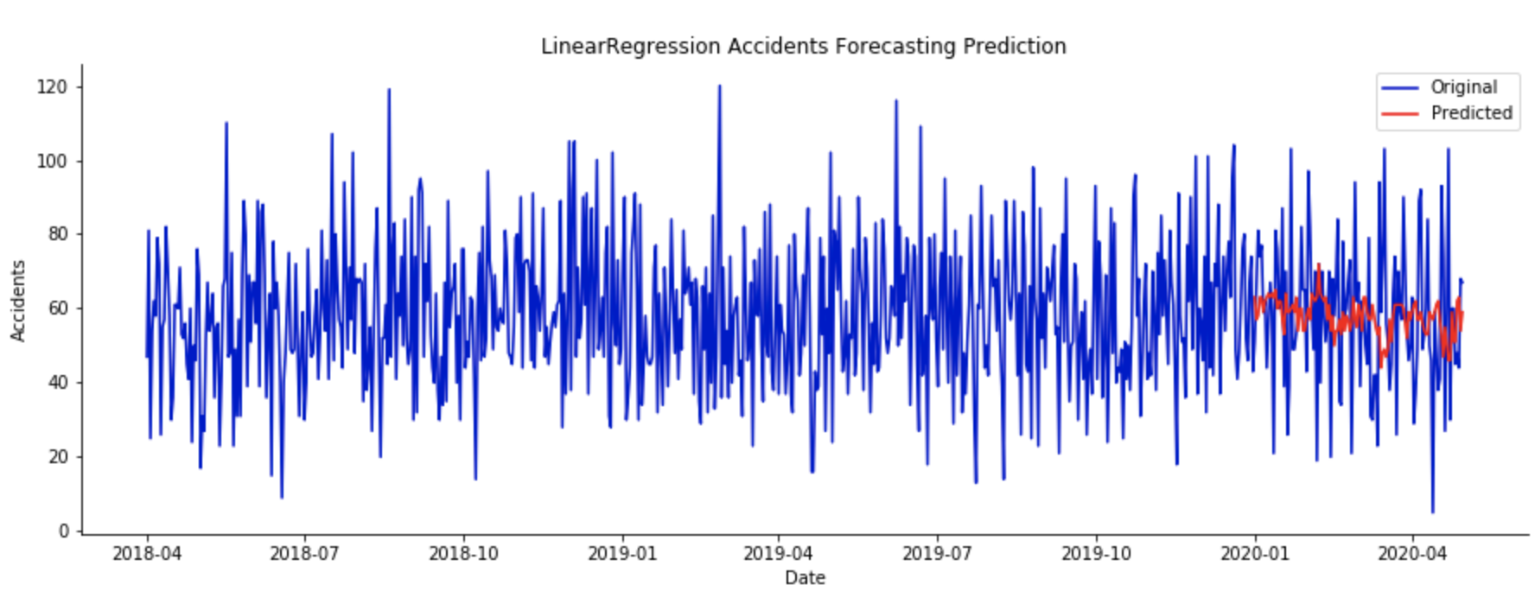
ML - Visualisation
Please visualize your prediction and provide an explanation;

